Slide 1
NIST is Risky
Notes:
successful organizations prevent problems by anticipating them.
Risk assessments help you anticipate problems.

Slide 2
Why Risk Assessments?
Effectively communicate risk
Build in security
Ensure business continuity
Maintain regulatory compliance
Motherhood
Apple pie
And other good things
Notes:
you only have a limited amount of resources to spend on security - you need to be able to know where to deploy these resources so that your organization gets the greatest cost/benefit ratio. This is what mgmt understands. You must speak their language to be effective.
last year's talk was about why you want to use risk management strategies to control threats and vulnerabilities.
Some of these are listed on this slide.

Slide 3
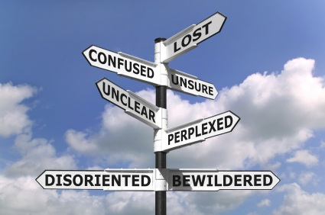
New for this year!
Notes:
This year I dig more into how to perform risk assessments.
Some people are better with starting with the abstract; some prefer the “skip the highfalutin theory – show me the action steps”. So today is focussing more those action steps.
All risk mgmt frameworks are guidelines for you to tailor to your organization.
COBIT Risk IT
OCTAVE
Today we focus on key steps in the federal NIST standard for risk management

Slide 4

Key concepts
Risk = f(event effect, effect likelihood)
Risk factors
Effect
Threat
Vulnerability
Likelihood
Uncertainty
Notes:
We’ll start with some key concepts
**Click**
In general , Risk is a function of the unwanted effect of an event and the likelihood of that effect.
**Click**
The primary factors to consider are:
**Click through factors**
Effect – the bad thing you don’t want to happen
Threat – the instigator of bad things
Vulnerability – how a threat could cause an unwanted effect
Likelihood – the chance of the effect happening due to the vulnerability
uncertainty inherent in risk evaluation
Illustrated example
? Threat – someone falls
? Vuln – floor is wet
? Effect – someone is hurt when fall
? Likelihood – have there been falls here before
? Uncertainty – these are all uncertain

Slide 5
Key concepts
Risk Assessments address potential harm
They can support a variety of activities
Architecture
Controls
Operations
Management Activities
Notes:
What does a RA do?
It addresses potential harmful effects
What activities does an RA support?
• Development of an information security architecture;
• Modification of business processes
• Operation and maintenance of security solutions
- non-security related risk mgmt activities, e.g.:
business continuity
regulatory compliance
reputation mgmt
project risk

Slide 6
Managing risk (NIST)
Frame risk
Assess risk
Respond to risk
Monitor risk
Notes:
NIST risk management
A four part process
Let’s go through each one

Slide 7
Part 1: Frame risk
Notes:
Sets you up for the following steps – how does your organization handle risk?
+ Assumptions & constraints on the execution of the risk mgmt process
financial
legal/regulatory
centralized/decentralized
+ level of risk tolerance
+ priorities & trade-offs considered by mgmt

Slide 8
Part 2: Assess risk
Prepare for the assessment
Conduct the assessment
Communicate the results
Maintain the assessment over time
Notes:
Pretty straightforward, eh?
Cautionary notes
- Risk assessments are often not precise instruments of measure (uncertainty)
Risk assessments should not be overworked
By this I mean keep your assessment broader rather than deeper. Take off the blinders.
The first step is important – proper planning prevents poor performance

Slide 9

eCommerce example
Notes:
As we go through the steps, let’s think of an example of a simple ecommerce system to sell widgets online.
We already sell widgets in our store, through the mail, and over the phone.
What new risks might we encounter by selling online?
And what are we going to do about them?

Slide 10
Step 1: Prepare for the assessment
Identify purpose
Identify scope
Notes:
Purpose – what decisions will the ra support?
Usually supports decisions on risk mitigations, but could also affect decisions about disaster recovery and business continuity
Scope – be very sure you don’t bite off more than you can chew. Start small, if you haven’t done these before.

Slide 11

Identify assumptions and constraints
Threats
Existing conditions
Risk tolerance & Uncertainty
Notes:
what threat sources going to be considered? adversarial and non-adversarial, like accidents?
Generally you will want to consider both.
Existing conditions – are we constrained by an specific architecture or physical location, for instance?
The Wicked Witch of the West could be melted by water, yet there were buckets of the stuff all around her castle.
risk tolerance & uncertainty – how much are you willing to tolerate?
(bertrand russell and the farmer feeding the chicken every morning. The chickens logic was faulty)

Slide 12
Identify assumptions and constraints
Orientation
Threat
Asset-effect
Vulnerability
Notes:
threat oriented (the risk that particular threats pose) or asset-effect oriented (the risk that identified assets are compromised) or vulnerability oriented (the risk that identified vulnerabilities could be harmfully exploited)?
? What do you think
It is crucial to select an approach that is appropriate for your desired approach and organization
level of detail – may depend on size of system or even size of organization

Slide 13
Step2: Conduct the risk assessment
Identify Threats
Identify Vulnerabilities
Determine Likelihood
Determine Effect
Determine Risk
Notes:
Five basic processes
All risk frameworks address each of these items

Slide 14

Identify adversarial threat sources
Consider:
Capability
Intent
Targeting
Adversary
Individual
Group
Organization
Nation-State
Notes:
Assess adversary capability (can they?)
Assess adversary intent (often based on incentive, i.e., do they want to?)
could someone have something to gain? Does the system deal with cash?
Assess adversary targeting (is it you?)
***click***
Individual (insider & outsider)
Group, ad hoc or established
Organization: competitor, supplier, partner, customer
? A competitor might be interested in who we’re selling to
Nation-state: if our widgets have military implications, for example
? What do you think are adversarial sources for our ecommerce?

Slide 15
Adversarial Threat Sources
Threat Source | In Scope | Capability | Intent | Targeting
Insider attack | Yes | High | High | High
External individual attack | Yes | Medium | Medium | Medium
Other organization attack | Yes | Medium | Medium | High
Notes:
An example of how this is documented NIST style
Simple. Communicates at a glance.

Slide 16
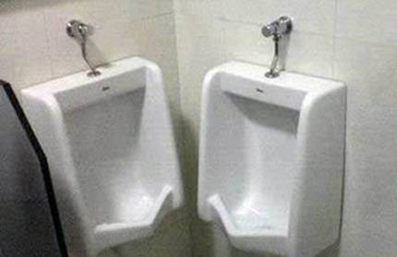
Identify Non-adversarial threat sources
Identify non-adversarial threat sources & effects
Accidents, acts of God, etc
Notes:
For relevant non-adversarial threat sources:
Assess the degree of effects from threat sources , from minor to horrible (use your org’s nomenclature)
?
Accidental: user or administrator
Somebody leaves an confidential report at the coffee bar.
Database not backed up properly
Structural: failure of equipment, environmental controls, or software
The A/C goes out, or the roof leaks, or the "leap second" that caused so many servers to go crazy last summer.
Environmental: storms, earthquakes, sunspots, loss of electrical supply

Slide 17

Threat Events & Sources
Threat events
Adversarial
Non-adversarial
Threat sources
(previous step)
Notes:
multiple threat sources can initiate a single threat event or any of multiple threat events.
to keep this manageable, the org can classify them by how an event affects one of an organization's concerns (Will it have a negative financial effect? Will it effect reputation? Will it compromise safety? etc).
Adversarial threat events include
?
create attack tools or conduct an attack
Deliver malicious capabilities.
Non-adversarial threat events
?
-Info loss, Unreadable display, disk error
-Fire, flood, earthquake, hurricane, etc
-Introduction of vulnerabilities into software products

Slide 18
Identification of Threat Events
Threat Event | Threat Source | Relevance
Credit card numbers released | Individual hacker | High
Slow response time | Poor database maintenance | Medium
Slow response time | Poor ISP contract terms | Low
Notes:
Just write them down. Again. Keep it Simple.
One reason it is simple is because the purpose of the assessment is to support executive decision.

Slide 19

Identify vulnerabilities
The ones vulnerable to your threats
Assess severity
Identify existing conditions
Notes:
identify vulnerabilities and existing conditions
?
Web app, credit cards
• Assess the severity of identified vulnerabilities
is the web app a proven, trusted app with credentials?
are we sure we’re PCI DSS compliant?
• Identify existing conditions
Is what you’re doing subject to legal, regulatory, or contractual requirements
Technical: needs to use specific technology in compliance with an architecture.
Operational: relies on operational controls, including site or personnel

Slide 20
Determine likelihood
Adversarial
initiation
Non-adversarial
occurrence
Notes:
Likelihood:– not used in the strict or statistical sense of the term. risk assessors assign a score (or likelihood assessment) based on available evidence, experience, and expert judgment.
First, what’s the likelihood the threat event will happen?
Second, what’s the likelihood the threat event will cause harm? You don’t have to worry about threat events for vulns you don’t have.
Then, combine the two for overall likelihood.
? OWASP top ten can give you an idea of incidence of web app problems
? We could review blogs, industry reports, etc
Adversarial – likelihood of initiation:
? Historical data, monitoring logs, incident reports
for non-adversarial – likelihood of occurance,
? Historical frequency of occurrence may be of greater use here

Slide 21
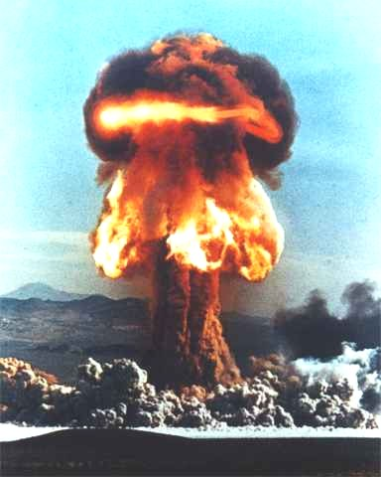
Determine effect (harm)
To operations
To assets
To individuals
To other organizations
Notes:
Identify adverse impacts of each threat event/vulnerability combination
Harm to Operations
? shipments disrupted, failure to meet contractual obligations , PCI DSS
Harm to Assets
? Loss of information or network
Harm to Individuals
? Identify theft
Harm to other organizations
? Failure to meet obligations
damage to trust
How bad could these be
? In some cases, significant

Slide 22

Determine risk
Generally, the combination of likelihood of the event and its harmful effect
Notes:
The formula for your organization would have been determined back in the “frame risk” part.
You can start with the general definition and refine it as you mature.

Slide 23
Communicate results to key personnel
Communicate results to decision makers to support risk responses.
Notes:
Communicate ra results with your now well-documented assessment

Slide 24

Maintain assessment over time
Ongoing monitoring of risk factors that contribute to changes in risk
Update existing assessment using the results from monitoring of risk factors
Notes:
This is where careful documentation of the process pays off. A year or two from now, the next review and update can simply pick up the previous assessment and update it.
This saves a tremendous amount of time.
It’s best if you have ongoing monitoring of risk factors that contribute to changes in risk
monitor the status of external threats.
monitor new vulnerabilities discovered.
Update existing assessment using the results from monitoring of risk factors.

Slide 25
Managing risk (NIST)
Frame risk
Assess risk
Respond to risk
Monitor risk
Notes:
Now we’ve done parts 1 and 2

Slide 26

Part 3: Respond to risk
What are we going to do with this information?
Notes:
provide a consistent response to risk in accordance with the organizational risk frame that we discussed earlier

Slide 27
Identify alternative courses of action
Accept
Mitigate
Share or transfer
Avoid
Bring it on!
Shields up!
Not me!
Just say no
Notes:
Identify alternative courses of action for responding to risks determined during the risk assessment;
accept, avoid, mitigate, share or transfer risk
Share or transfer risk It is important to note that risk transfer reduces neither the likelihood of harmful events occurring nor the consequences in terms of harm to organizational operations and assets, individuals, or other organizations
Evaluating the alternative courses of action;
Decide on the appropriate courses of action consistent with organizational risk tolerance;
Implementing risk responses based on selected courses of action.

Slide 28

Part 4: Monitor risk
Ensure accountability
Periodic review
Notes:
If you decide to implement mitigating controls, you must assign responsibility. If no one is accountable, the control is almost certain to fail when needed.
Controls should also have a way to be tested for efficacy, and tested periodically. Untested controls have a way of failing when you need them.
Identify changes which affect risk levels.
Verify compliance with organizational missions/business functions, federal legislation, directives, regulations, policies, standards, etc

Slide 29

Get Management Sign-off
Notes:
Mgmt must agree to the risks, responses, and ongoing responsibilities.
Otherwise you won’t have much to show for your efforts

Slide 30




What can go wrong?
Notes:
Multiple threat sources and vulnerabilities can lead to a given threat event. This is why defense in depth – multiple controls against a given threat event or a given vulnerability or a given asset – is a good idea if the potential harm is high
And remember accountability is crucial

Slide 31

What can go right?
Notes:
The NIST, and other risk management frameworks,
allow you to develop a repeatable, documentable process for assessing risk and responding to it appropriately.
The process fits *your* organization.
You can plan actions to avoid problems.
You avoid a “compliance checkoff” mentality that doesn’t really improve security.
You avoid reinventing the wheel.
You establish consistency.
You can establish benchmarks and metrics around risk
You become more efficient.
And not least, You raise security awareness in your organization.
? Any reason not to?

